Slide 1

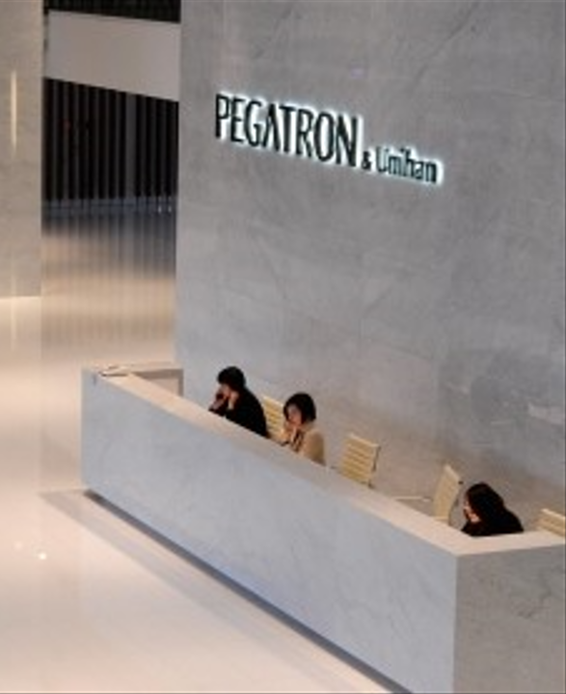


BG6
PVN
2026 PVN FME Q3 Work Report
Dep.: BG6- Manufacturing& Operation Management Center.- Viet Nam Manufacturing Div.- PVN1 Factory- FME Dept.- Automation Sec.
Name: Rabbit Pham 范氏垂
Date: 2026/09/18
FME
BG6 PVN

Slide 2
BG6
PVN
Q2, Q3 - 2026 Work Results
Time | Work Results
2026 Q2 | 1. Following the previous quarter, continued to enhance my knowledge and hands-on experience with new AOI equipment and programs.
 | 2. Participated in the setup and commissioning of new AOI stations on production lines, including the installation and configuration of inspection programs for new machines.
2026 Q3 | 3. Conducted AI model training for new models, carried out trial runs and validation. Submitted PCN requests through the company system for online production approval.
 | 4. Monitored the progress and status of AOI projects and regularly updated the weekly report to ensure timely tracking and follow-up.
FME
BG6 PVN

Slide 3
BG6
PVN
Detailed description of Work results
1
AOI Aurora (4F Line)_ Include Aurora1, Aurora2, Aurora3, Aurora4, Aurora5.
1
4
2
5
3
FME
BG6 PVN

Slide 4
BG6
PVN
Detailed description of Work results
AOI Aurora (4L Line)
Inspection Program
SFIS Data
FME
BG6 PVN

Slide 5
BG6
PVN
Detailed description of Work results
AOI R30 (4N Line)
Inspection Program
SFIS Data
FME
BG6 PVN

Slide 6

BG6
PVN
Detailed description of Work results
and commissioning of new AOI stations on production lines
2
Setup and commissioning of new AOI stations on production lines.
Participated in setting up camera, led and jig for the Aurora AOI station(4F).
Set up the camera to fully cover the product and clearly capture all required details.
Adjusted the lighting to achieve optimal illumination without dark or overexposed areas.
Prepared jigs to securely fix the product position, ensuring stable and consistent inspection.
Aurora AOI Station(4F)
RESULT
Ensured stable production and consistent inspection results.
FME
BG6 PVN

Slide 7

BG6
PVN
Detailed description of Work results
and commissioning of new AOI stations on production lines
2
Setup and commissioning of new AOI stations on production lines.
Participated in setting up camera, led and jig for the Aurora AOI station(4L).
Set up the camera to fully cover the product and clearly capture all required details.
Adjusted the lighting to achieve optimal illumination without dark or overexposed areas.
Prepared jigs to securely fix the product position, ensuring stable and consistent inspection.
Aurora AOI Station(4L)
RESULT
Ensured stable production and consistent inspection results.
FME
BG6 PVN

Slide 8
BG6
PVN
Detailed description of Work results
and commissioning of new AOI stations on production lines
2
Setup and commissioning of new AOI stations on production lines.
Participated in setting up jig for the Revlon1,3(4D).
FME
BG6 PVN

Slide 9
BG6
PVN
Detailed description of Work results
3
Training new models, carried out trial runs and validation.
Model
1
AI Training
1
Trial run & Validation
1
PCN Submission
FME
BG6 PVN

Slide 10

BG6
PVN
Detailed description of Work results
3
Training new models, carried out trial runs and validation.
Model
1
AI Training
1
Trial run & Validation
1
PCN Submission
FME
BG6 PVN

Slide 11
BG6
PVN
Detailed description of Work results
3
Training new models, carried out trial runs and validation.
Model
1
AI Training
1
Trial run & Validation
1
PCN Submission
FME
BG6 PVN

Slide 12
BG6
PVN
Detailed description of Work results
setup and commissioning of new AOI stations on production lines
4
Monitored the progress and status of AOI projects, updated the weekly report.
FME
BG6 PVN

Slide 13
BG6
PVN
Work and Self-Development Plan: Q4 2026 – Q1 2027
Time | Work and Self- Development Plan
2026 Q4~
FME
BG6 PVN

Slide 14
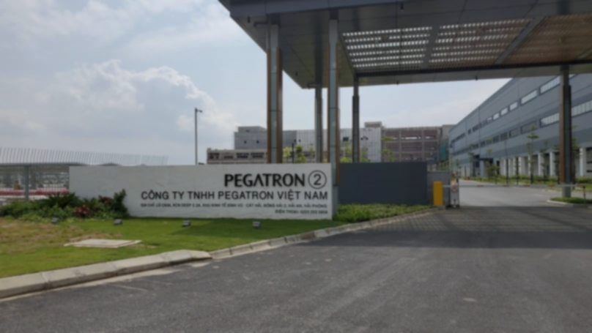
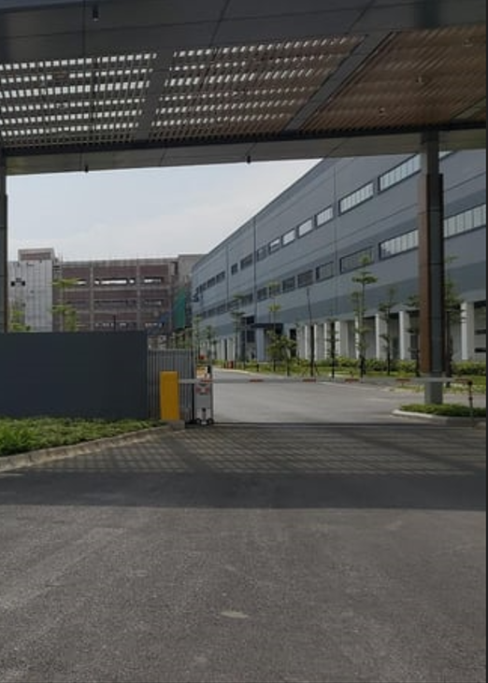
Thank You

